Slide 1



UNIVERSITY INSTITUTE OF ENGINEERING
COMPUTER SCIENCE ENGINEERING
Bachelor of Engineering
Design and Analysis of Algorithms(CST-311/ITT-311)
Topic: Convex Hull
DISCOVER . LEARN . EMPOWER

Slide 2
Learning Objectives & Outcomes
Objective:
To understand the concept of Convex Hull.
Outcome:
Student will understand
Concept of Convex Hull.

Slide 3
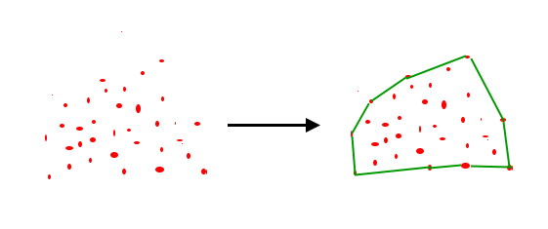
Convex Hull (Jarvis’s Algorithm or Wrapping)
Given a set of points in the plane. the convex hull of the set is the smallest convex polygon that contains all the points of it.

Slide 4
How to check if two line segments intersect?
The idea of Jarvis’s Algorithm is simple, we start from the leftmost point (or point with minimum x coordinate value) and we keep wrapping points in counterclockwise direction.
The big question is, given a point p as current point, how to find the next point in output? The idea is to use orientation() here.
Next point is selected as the point that beats all other points at counterclockwise orientation, i.e., next point is q if for any other point r, we have “orientation(p, q, r) = counterclockwise”.

Slide 5
Algorithm
1) Initialize p as leftmost point.
2) Do following while we don’t come back to the first (or leftmost) point.
…..a) The next point q is the point such that the triplet (p, q, r) is counterclockwise for any other point r.
…..b) next[p] = q (Store q as next of p in the output convex hull).
…..c) p = q (Set p as q for next iteration).

Slide 6
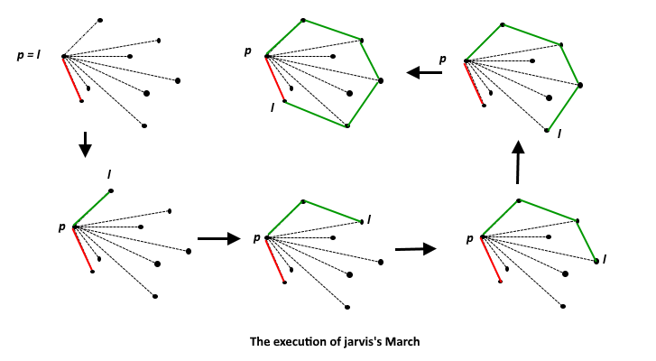
Example

Slide 7
Convex Hull (Graham Scan Algorithm)
We have discussed Jarvis’s Algorithm for Convex Hull. The worst case time complexity of Jarvis’s Algorithm is O(n^2). Using Graham’s scan algorithm, we can find Convex Hull in O(nLogn) time. Following is Graham’s algorithm
Let points[0..n-1] be the input array.

Slide 8
Convex Hull (Graham Scan Algorithm) (Contd.)
Phase 1 (Sort points): We first find the bottom-most point. The idea is to pre-process points be sorting them with respect to the bottom-most point. Once the points are sorted, they form a simple closed path.
What should be the sorting criteria? computation of actual angles would be inefficient since trigonometric functions are not simple to evaluate. The idea is to use the orientation to compare angles without actually computing them (See the compare() function below)

Slide 9
Convex Hull (Graham Scan Algorithm) (Contd.)
Phase 2 (Accept or Reject Points): Once we have the closed path, the next step is to traverse the path and remove concave points on this path. How to decide which point to remove and which to keep? Again, orientation helps here.
The first two points in sorted array are always part of Convex Hull. For remaining points, we keep track of recent three points, and find the angle formed by them. Let the three points be prev(p), curr(c) and next(n).
If orientation of these points (considering them in same order) is not counterclockwise, we discard c, otherwise we keep it. Following diagram shows step by step process of this phase

Slide 10
REFERENCES
Text books:
Cormen, Leiserson, Rivest, Stein, “Introduction to Algorithms”, Prentice Hall of India, 3rd edition 2012. problem, Graph coloring.
Websites:
https://www.geeksforgeeks.org/convex-hull-set-1-jarviss-algorithm-or-wrapping/
https://www.geeksforgeeks.org/convex-hull-set-2-graham-scan/

Slide 11
THANK YOU

